Slide 1

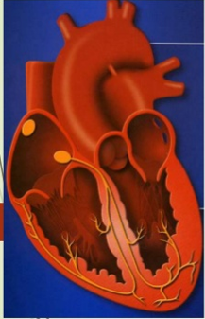
DRUGS IN
CCF
BY
DR.G.AARTHIPRIYANKA
POST GRADUATE
DEPARTMENT OF PHARMACOLOGY

Slide 2


Slide 3
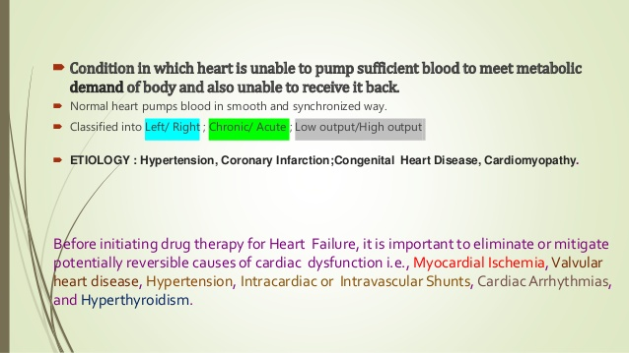

Slide 4
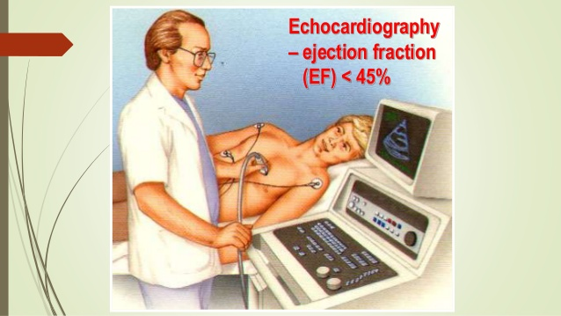

Slide 5
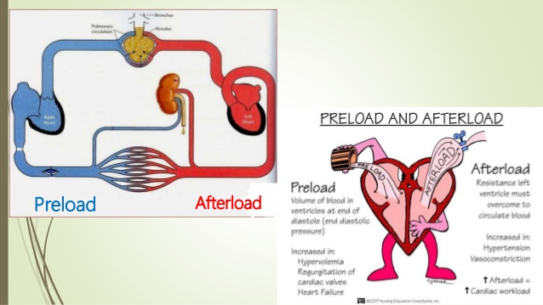

Slide 6
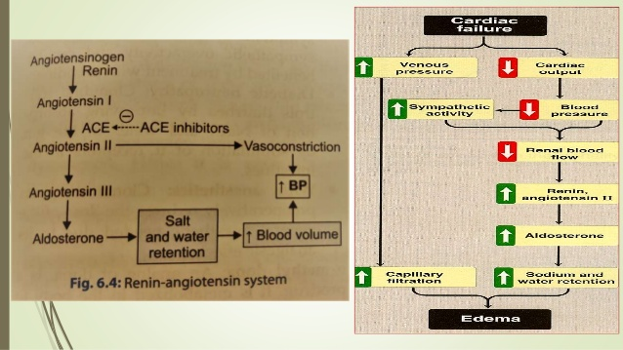

Slide 7
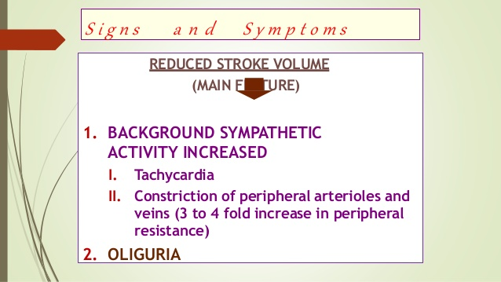

Slide 8
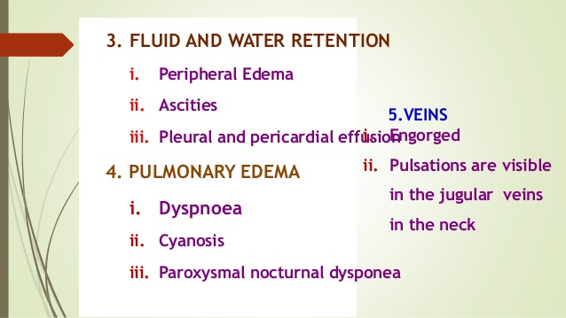

Slide 9
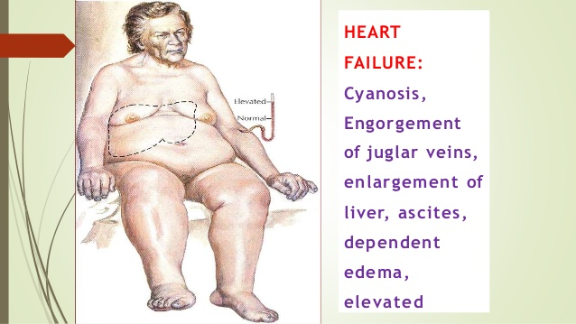

Slide 10


Slide 11
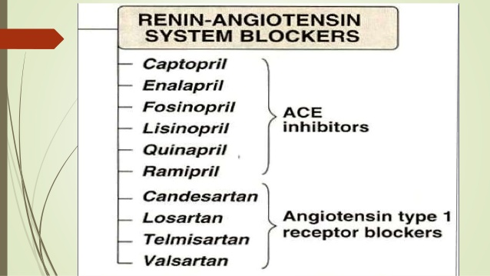

Slide 12
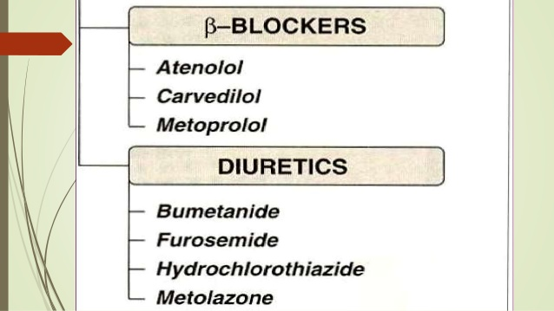

Slide 13
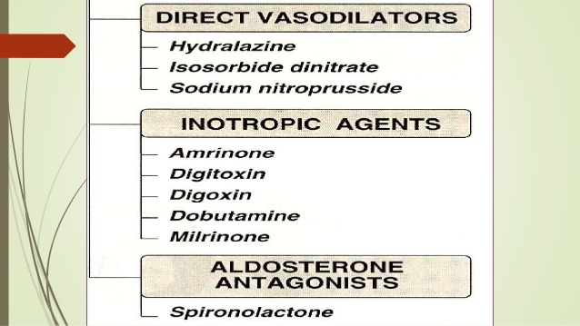

Slide 14
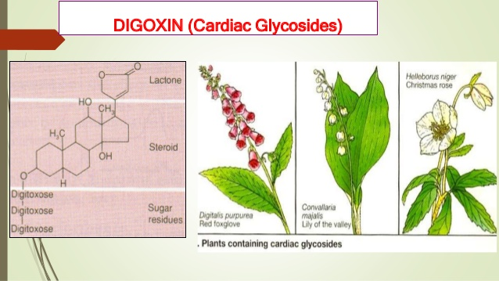

Slide 15
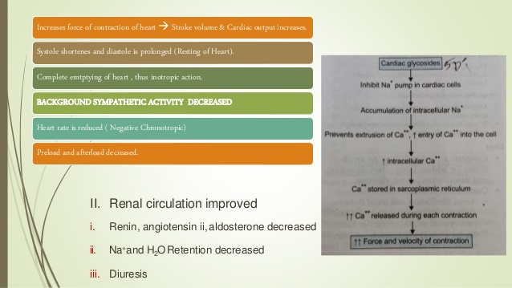

Slide 16
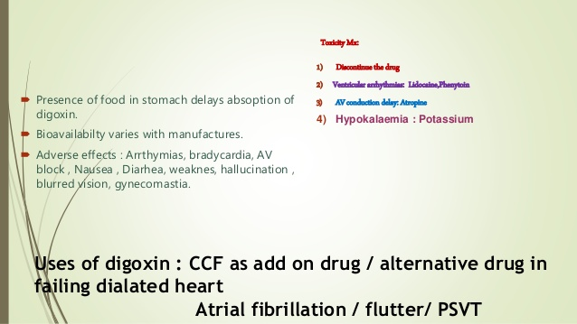

Slide 17
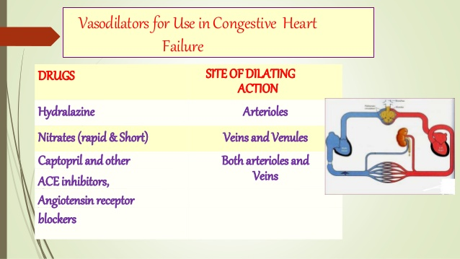

Slide 18
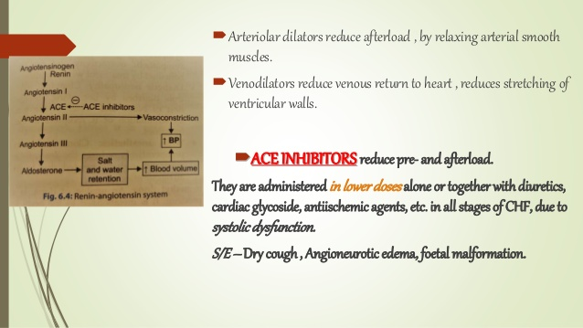

Slide 19
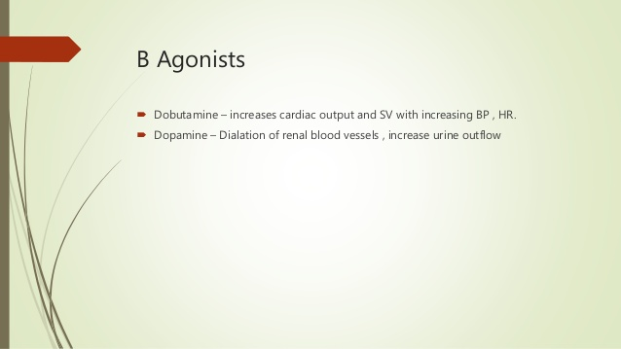

Slide 20
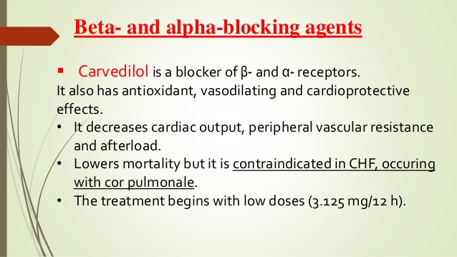

Slide 21
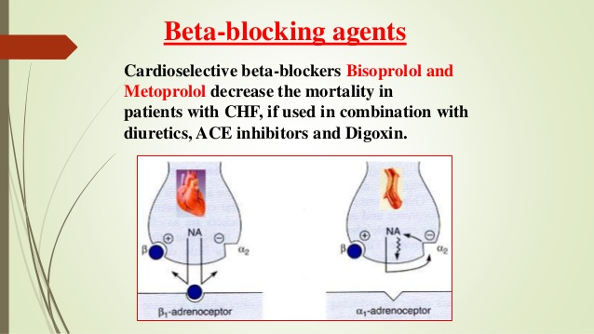

Slide 22
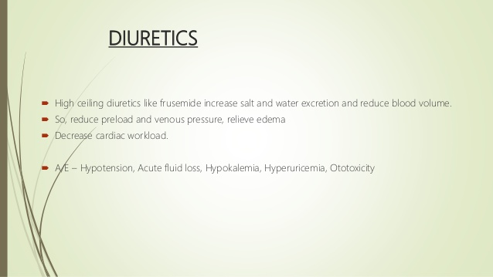

Slide 23
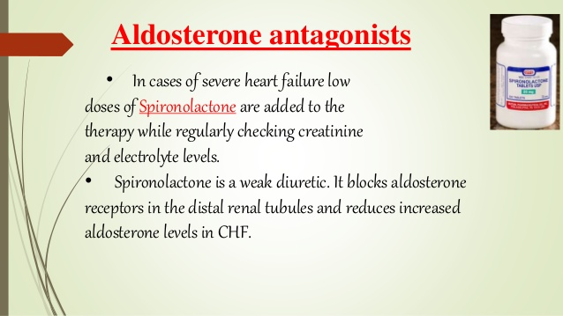

Slide 24
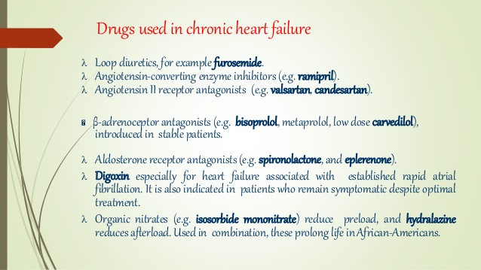

Slide 25
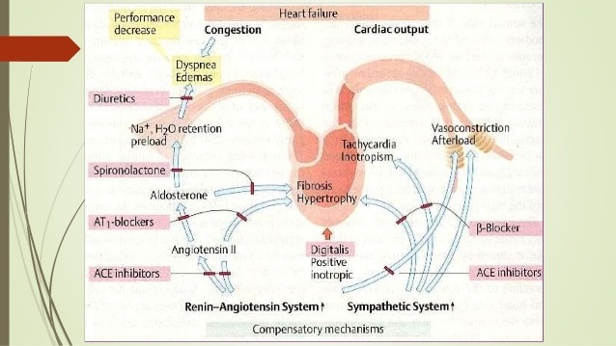

Slide 26
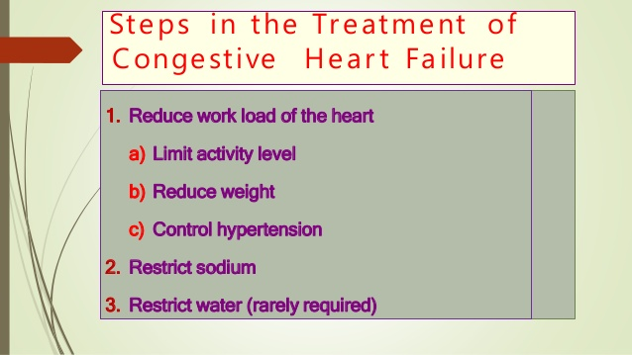

Slide 27
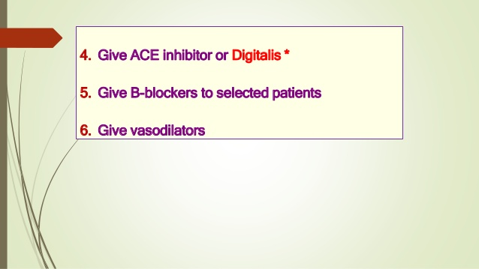

Slide 28
DRUGS WITH POSITIVE INOTROPIC EFFECTS:
CARDIAC GLYCOSIDES:Digoxin
BIPYRIDINES:Milrinone
B-Adrenergic agonist:Dopamine
DRUGS WITHOUT POSITIVE INOTROPIC EFFECTS:
DIURETICS:Furosemide
ACEIs:Ramipril
B1 ANTAGONIST:Carvedilol
VASODILATORS:Hydralazine,ISDN
VASOPRESSIN RECEPTOR ANTAGONIST:Tolvaptan

Slide 29
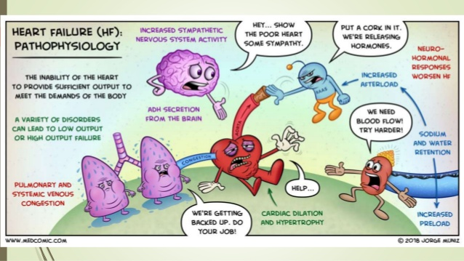

Slide 30
